Slide 2
Digital Forensics Lecture-17
By- Dr.subhranil Das
Assistant Professor
School of computer Science

Slide 3

Contents
1. File system forensics
2. Understanding file systems
3. Recovering deleted data
4. Memory forensics
5. Extracting and analysing volatile memory

Slide 4

File Formats
Many kinds of files have a distinctive structure that was designed by software developers or standards bodies, and that can be useful for classifying and salvaging data fragments.
For instance, a graphics file format such as JPEG has a completely different structure from Microsoft Word documents, starting with the first few bytes at the beginning of the file (the “header”), continuing into the locations where data are stored in the main body of the file, and terminating with a few distinctive bytes at the end of the file (the “footer”).

Slide 5
Common headers of the file
The common headers in a JPEG image, Word document, and other file types are often referred to as file signatures
and can be used to locate and salvage portions of deleted files.
The process of searching for a certain file signature and attempting to extract the associated data is called “carving” because it conceptually involves cutting a specific piece of data out of a larger dataset.

Slide 6
Carving
Carving in the context of digital forensics uses characteristics of a given class of files to locate those files in a raw data stream such as unallocated clusters on a hard drive.
For instance, the beginning and end of a Web (HTML) page are demarked by “<html>” and “</html>” respectively.. The characteristic “FF D8 FF” hexadecimal values indicate that this is the beginning of a JPEG-encoded file and the characteristic “Exif” indicates that it is an Exchangeable Image File Format file common on digital cameras

Slide 7
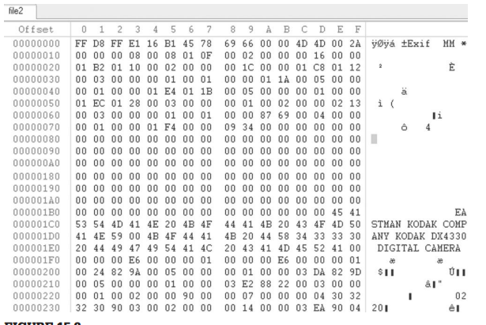
Example of JPEG-encoded EXIF file

Slide 8
To make this process more efficient, tools have been developed to automate the process of carving for various file types, including, foremost, scalpel and DataLifter.
Specialized forensic tools like EnCase, FTK, and X-Ways also have some carving capabilities.
These tools can be useful for recovering digital video segments created using Webcams, which are often in AVI, MPEG, or Quicktime format and may be deleted frequently.
This carving technique also works for extracting files from physical memory dumps from mobile devices and from raw network traffic.

Slide 9
Limitations
First, the file name and date-time stamps that were associated with a file when it was referenced by the file system are not salvaged along with the data.
Second, the size of the original file may not be known, making it necessary to guess how much data to carve out.
Third, when the original file was fragmented, a simple carving process that assumes all portions of the file were stored contiguously on the disk will fail, salvaging fragments of multiple files and incorrectly combining them into a single container.

Slide 10
Data Hiding
There are a few nuances to hard drives that enable a wily individual to conceal the presence of large amounts of data on them.
The first cylinder on a disk (i.e the maintenance track) is used to store information about the drive such as its geometry and the location of bad sectors.
By intentionally marking portions of the disk as bad, an individual can conceal data in these areas from the operating system.
The evidence collection tools described in this text are not fooled by this technique and some utilities such as Anadisk3 can copy the maintenance track of a floppy disk.
Another potential area for data hiding is the Protected Area on post 1998-ATA disks. As the name suggests, most programs cannot access this area but several forensic tools have been developed to detect and copy this area

Slide 11
File Systems
File systems such as FAT16, FAT32, NTFS, HFS (Macintosh Hierarchical Filesystem), HFS+, Ext2 (Linux), and UFS (Solaris) keep track of where data are located on a disk, providing the familiar file and folder structure.
Before a file system can be created, a partition must be created to specify how much of the hard drive it will occupy.
The first sector of a hard disk contains the Master Boot Record (MBR) containing a partition table to tell the operating system how the disk is divided.

Slide 12
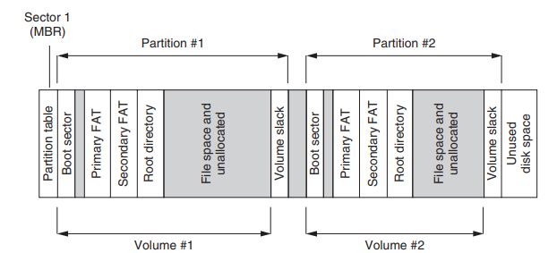
File Systems

Slide 13
Explanation
The partition table specifies the first and last sectors in each partition, as well as additional information about the partition.
The simplest example of creating or viewing a partition is using the fdisk command.
The following example shows output from the Linux fdisk command run on a Dell computer with two hard drives—one hard drive has a small partition for recovery purposes and a larger partition containing an NTFS file system (Windows NT/2000/XP), and the other hard drive has several partitions containing an ext2 file system (Linux). A failure to realize that this system has two hard drives could result in lost digital evidence.

Slide 14
Example
The following output from the Windows fdisk command shows a hard drive with one primary partition and an extended partition that is subdivided into four smaller partitions.
The use of extended partitions is necessary because the partition table has room for four primary partitions only an extended partition can be subdivided into additional partitions without entries in the partition table.

Slide 15
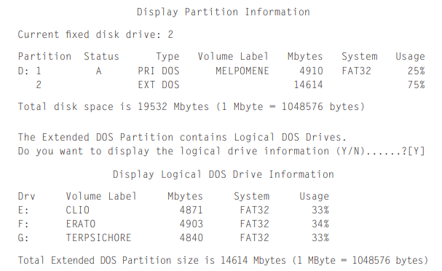
Example of the partitioned disk

Slide 16
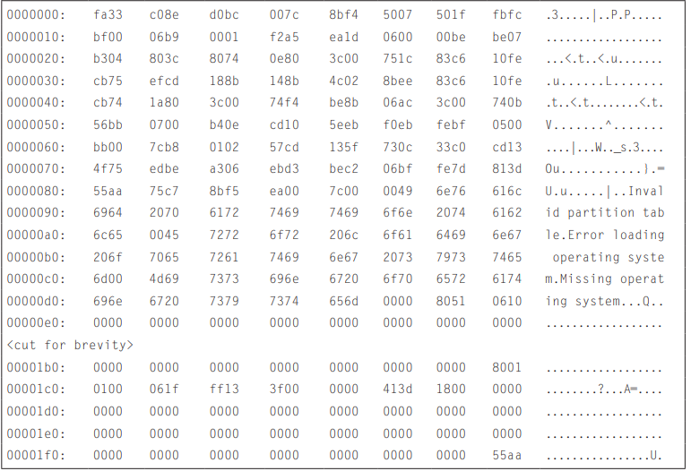
Partition Table in Raw Form as Stored on Disk

Slide 17
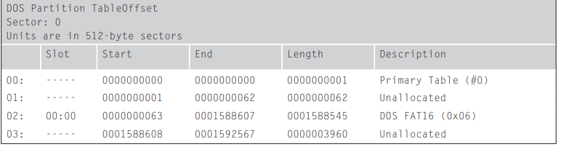
Partition Table in Interpreted Form Displayed Using Mmls from the Sleuthkit

Slide 18
Explanation
From a forensic perspective, it is important to understand what data look like at a low level.
A partition table with one entry as it is seen on a disk vs how it is interpreted using a utility such as mmls from the Sleuthkit.
The partition starts at sector 63 (hexadecimal 3f) and its size is 1588545, which is 18 3D 41 in hexadecimal, which is represented as 41 3D 18 in little-endian as shown in Table.
Once a partition has been created, it can be formatted with any file system.
For instance, a FAT file system can be created using the format command on Windows.
The area occupied by the file system is called a volume, which is assigned a letter such as C: by the operating system.

Slide 19
Next Lecture
File Forensics-II
.

